Slide 1
STRIDOR
Dr. Prathana Seles
SR Ent Department
TMCH

Slide 2
Stridor
An abnormal, high-pitched sound produced by turbulent airflow through a partially obstructed airway at the level of the supraglottis, glottis, subglottis, and/or trachea.
Stridor is a symptom, not a diagnosis or disease, and the underlying cause must be determined.
Implies partial airway obstruction
Should be differentiated from stertor, which is a lower-pitched, snoring-type sound generated at the level of the nasopharynx, oropharynx, and, occasionally, supraglottis.
Notes:
Until proven otherwise, patients with marked variation in pattern of stridor have a foreign body obstruction
Quality of pitch not clinically useful for diagnosis
Age of patient will narrow the differential diagnosis

Slide 3
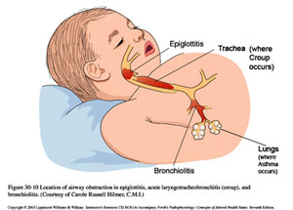
Stridor may be inspiratory, expiratory, or biphasic depending on its timing in the respiratory cycle.
Inspiratory stridor suggests a laryngeal obstruction
while expiratory stridor implies bronchial obstruction
Biphasic stridor suggests a tracheal (subglottic or glottic anomaly.)

Slide 4
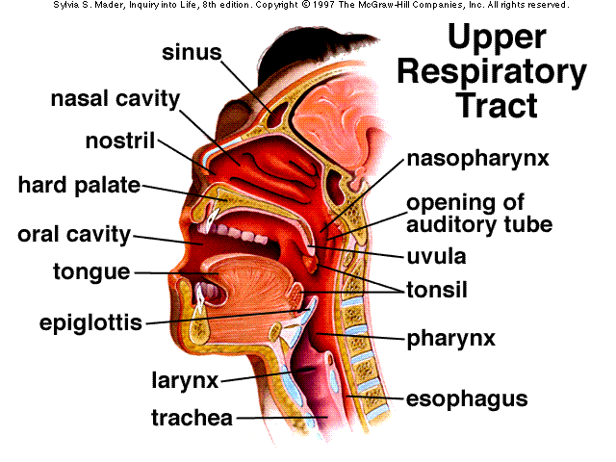

Slide 5
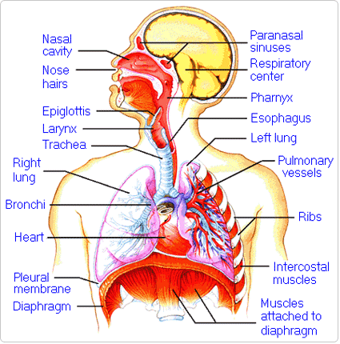

Slide 6
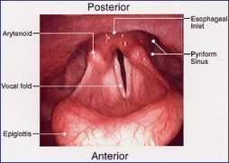

Slide 7
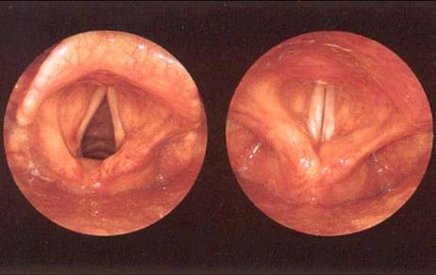

Slide 8
Laryngeal Stridor: Etiology
Congenital Laryngeal Anomalies
  Laryngomalacia-different types
  Tracheomalacia
  Vocal Cord Paralysis
  Laryngeal Clefts
  Vascular Rings and Slings
Infectious
  “Croup” (Laryngotracheitis)
  Epiglottitis
  Tracheitis
Trauma
Croup Masquerade
  Subglottic Hemangioma
  Recurrent Respiratory Papillomatosis
  Post Intubation Glottic and Subglottic Lesions
  Congenital Glottic and Subglottic Stenosis
  Extra-Esophageal (Gastroesophageal) Reflux Disease/Eosinophilic Esophagitis
Foreign Body
  Tracheal
  Esophageal

Slide 9
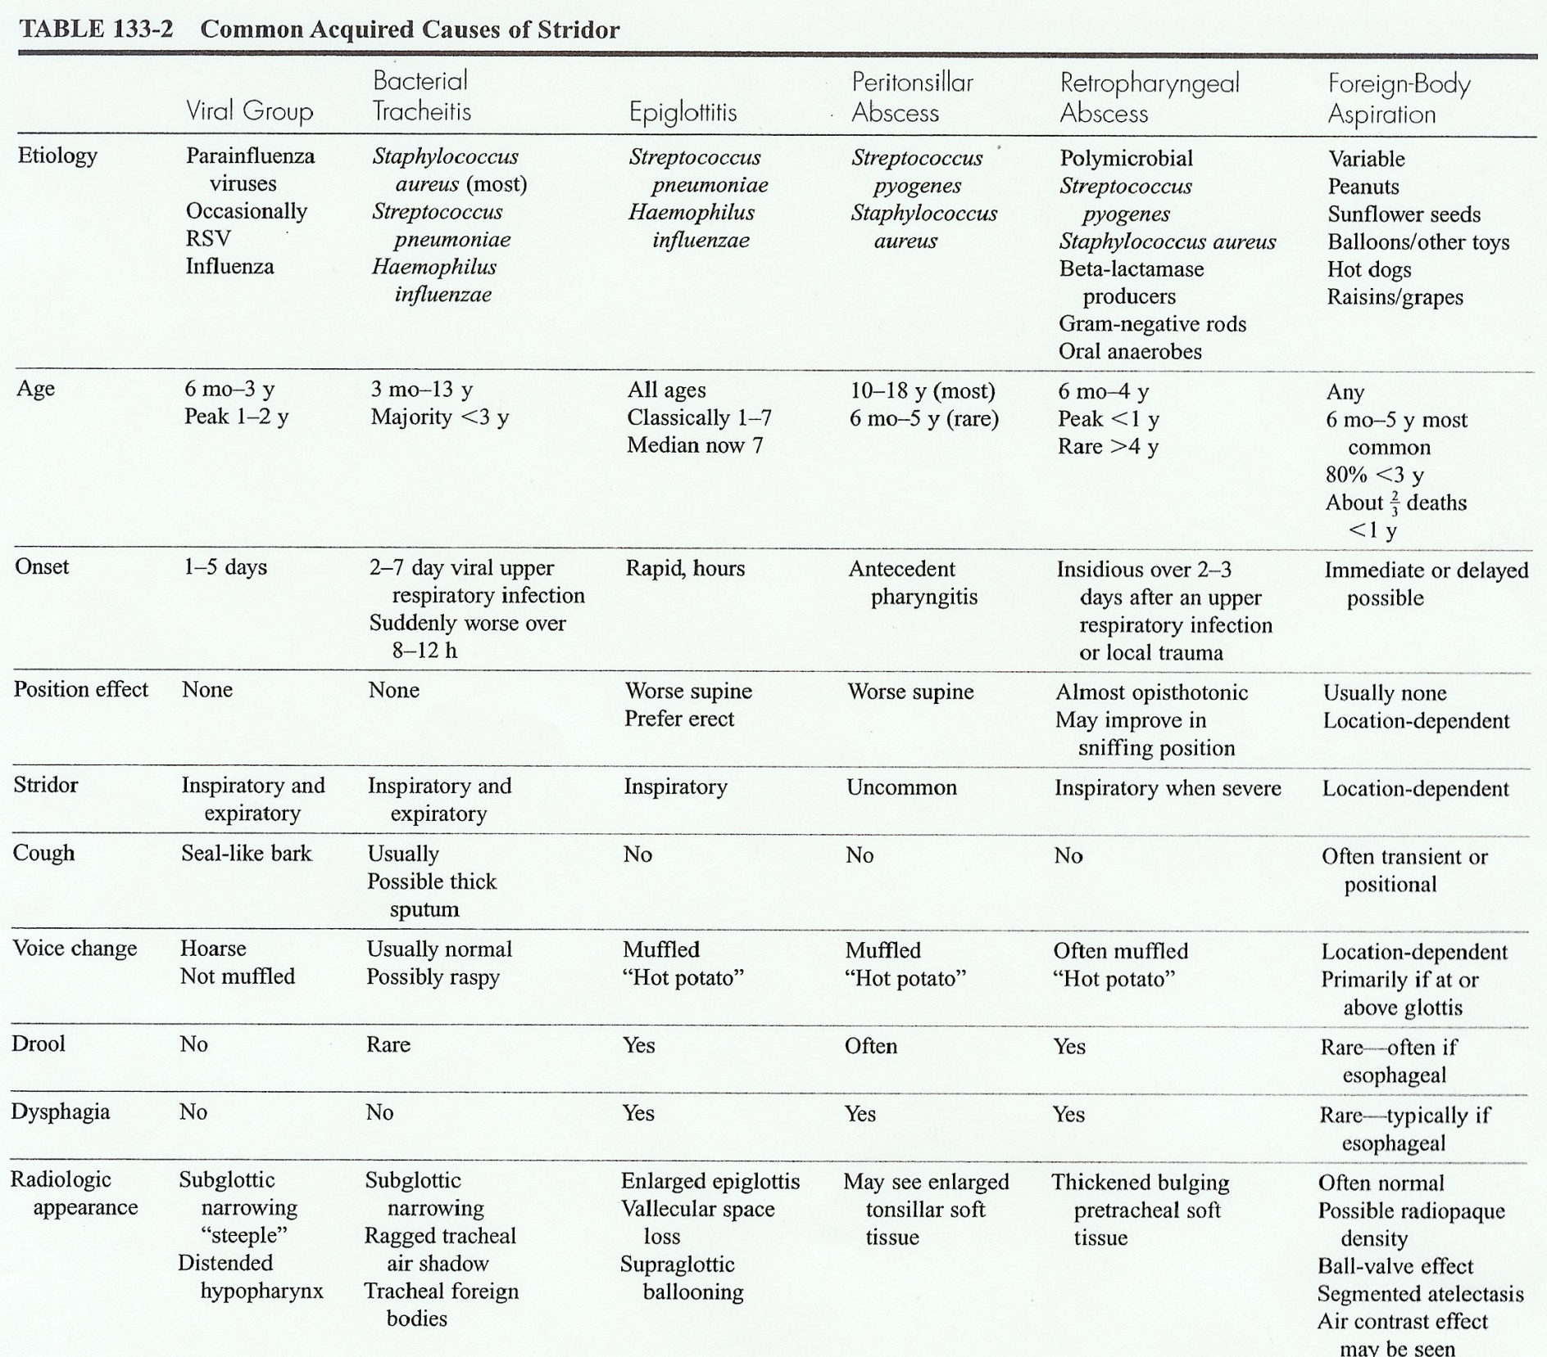

Slide 10
CAUSES
neonate
Laryngomalacia 1st Vocal cord dysfunction 2nd Congenital tumours Choanal atresia Laryngeal webs | Chronic Chronic Chronic Chronic Chronic
Chilld
Infection -epiglottitis -Laryngitis Croup : 1-2 days duration less severe FB Laryngeal dyskinesia | acute Acute Acute chronic
adult
Infection -epiglottitis -Laryngitis Trauma – acquired stenosis CA Larynx or Trachea or main bronchus | Acute Acute chronic

Slide 11
CAUSES OF ACUTE STRIDOR
Laryngotracheobronchitis ( croup)
Epiglottitis
Bacterial tracheitis
Foreign body
Angioedema
Hypocalcemic tetany
Edema after endotracheal intubation

Slide 12
PATHOPHYSIOLOGY
The obstruction can be fixed or variable.
Variable extrathoracic obstructions are primarily associated with inspiratory stridor.
This is because, during inspiration, extrathoracic intraluminal airway pressure is negative relative to atmospheric pressure, leading to collapse of supraglottic structures.
During expiration, intrathoracic pressure is positive and tends to collapse the airway.
Thus, stridor caused by intrathoracic obstructions tends to be more prominent upon expiration.
Stridor heard during both phases of respiration is usually due to either a fixed airway obstruction or to 2 areas of obstruction (ie, intrathoracic and extrathoracic).

Slide 13
ASSESSMENT STRATEGIES
Guide to diagnosis and intervention
  Age
  Congenital vs. Acquired
  Characteristics of stridor
  Clinical picture

Slide 14
CLINICAL PICTURE: HISTORY
Onset: acute, chronic, progressive
Prior respiratory problems
NICU stay
Prior intubation
GERD symptoms
Wheezing episodes
Feeding problems:
  FTT, weight gain
Choking episodes
Acute events
Notes:
Patient profile
Name age address …etc
Main complain
Stridor (duration )
HPI
Place particular emphasis on the age of onset, duration, severity, and progression of the stridor; precipitating events (eg, crying, feeding); positioning (eg, prone, supine, sitting); quality and nature of crying
presence of aphonia; and other associated symptoms (eg, paroxysms of cough, aspiration, difficulty feeding, drooling, sleep disordered breathing). elicit history of color change, cyanosis, respiratory effort, and apnea to determine the severity of stridor.
ROS
ENT , the respiratory tract, the cardiovascular system, the GI system, and CNS.and all
( PeriNatal )
*maternal endotracheal intubation use and duration, and presence of congenital anomalies.
*developmental history.
*A feeding and growth history should be evaluated because significant airway obstruction can lead to caloric waste, resulting in lack of or slow weight gain and growth. Additionally, regurgitation and spitting up could be a sign of gastroesophageal reflux (GER) that can cause irritation of the mucosa of the larynx and trachea that could lead to edema and stridor.
other
Past Medical / Drugs / social / family history

Slide 15
CLINICAL PICTURE: ASSOCIATED SIGNS & SYMPTOMS
Acute Disease
  Fever
  Drooling (new onset)
  Change in cry or voice
  Decrease in oral intake
  Body position

Slide 16
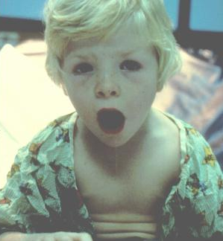
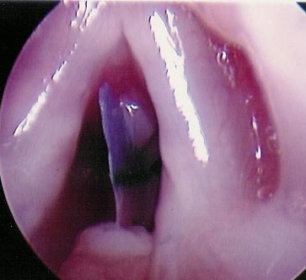
INITIAL EVALUATION
Assess urgency
  Is there acute distress?
    Nasal flaring
    Tachypnea
    Cyanosis
    Retractions
    Tripod position
  Immediate action !

Slide 17
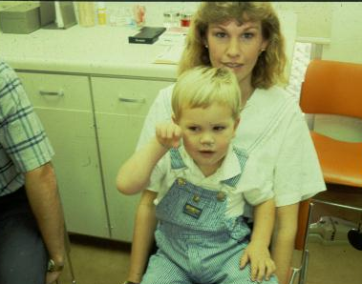
PHYSICAL EXAMINATION
Let parent hold child

Slide 18

PHYSICAL EXAMINATION
DO NOT try to examine the throat in patient with stridor as this may induce laryngospasm and total airway obstruction.
Signs of distress or cyanosis, use of accessory muscles of respiration, nasal flaring, level of consciousness, and responsiveness.
Vital signs
Routine full examination

Slide 19
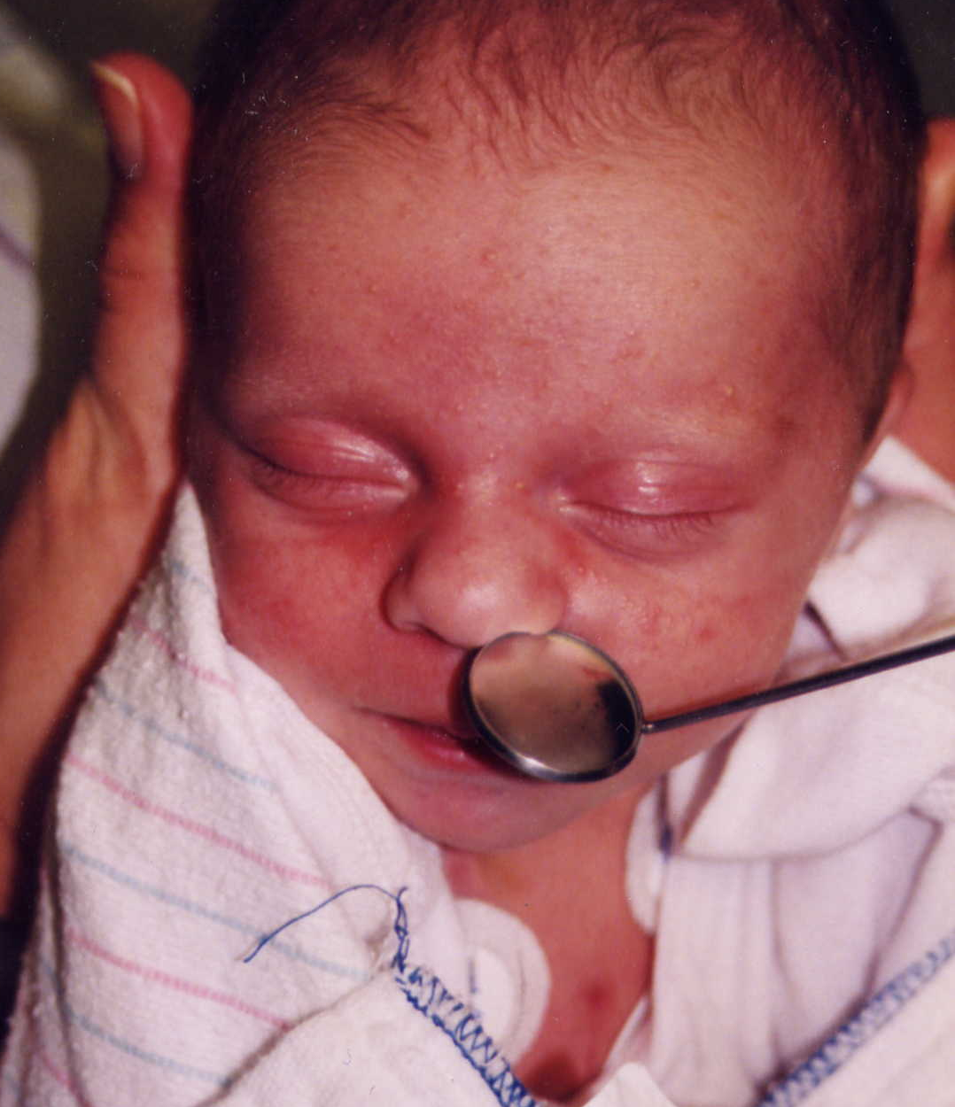
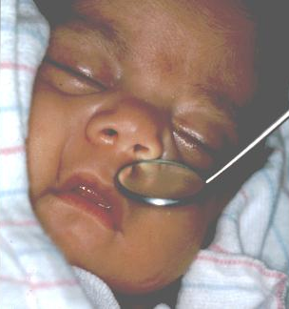
PHYSICAL EXAMINATION
Mirror for nasal airflow (stertor vs stridor)

Slide 20
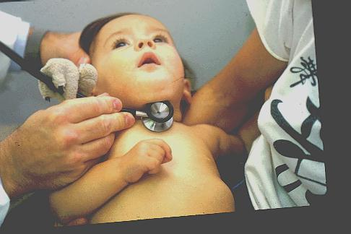
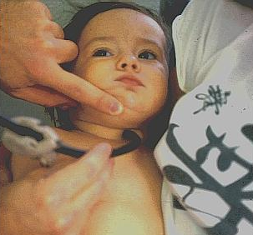
PHYSICAL EXAMINATION
“Headless” stethoscope

Slide 21
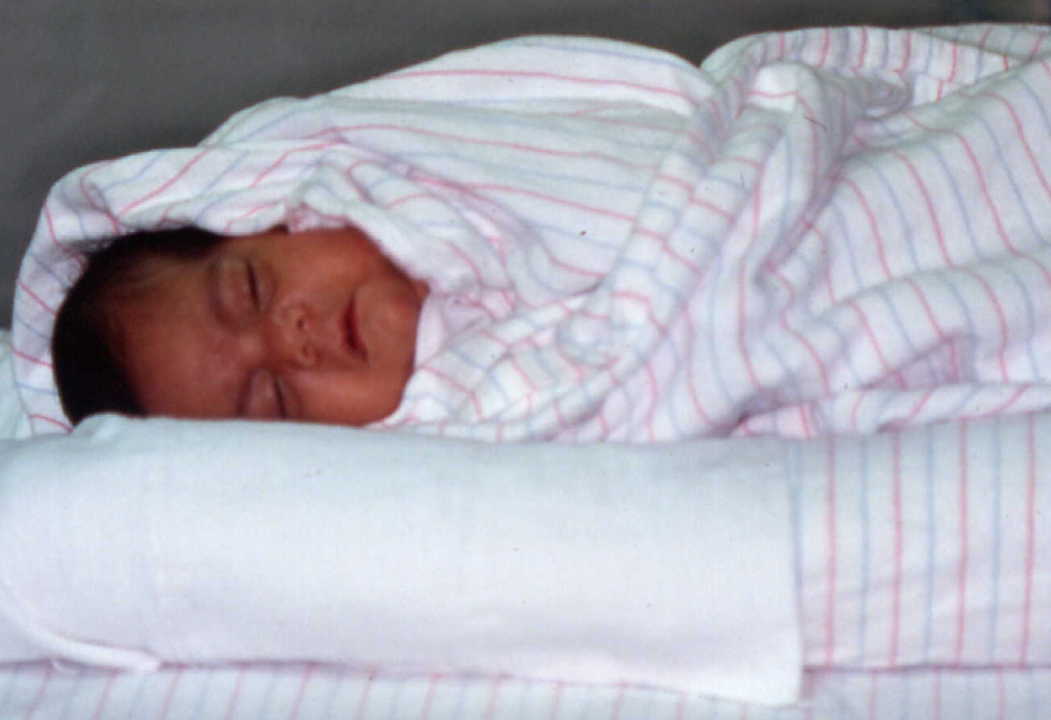
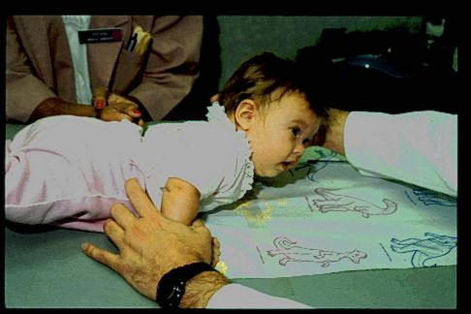
PHYSICAL EXAMINATION
Positional changes

Slide 22
ASSESSMENT OF SEVERITY OF STRIDOR
Timing :
  The prominent phase of respiratory noise should be inspiratory
  Expiratory stridor ----- more severe, or intrathoracic obstruction
Work of breathing :
  Increased RR
  Sternal ( supra – sub ) recession
How effective is the breathing :
  Chest expansion
  Breath sounds for air entry
Is there adequate oxygenation :
  Is HR increased
  Pallor , cyanosis
  O2 saturation
  Activity level

Slide 23
WORRYING SIGNS IN CHILDREN WITH STRIDOR
High fever or signs of toxicity
Rapid onset
Drooling & dysphagia
Muffled voice & quiet stridor
Angioedema
Age less than 4 mths
Skin cavernous hemangioma
Previous ventilation as a neonate

Slide 24
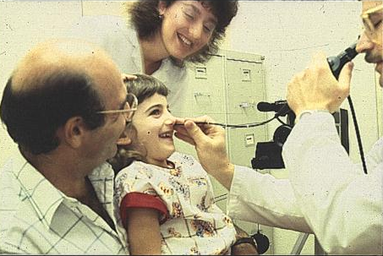
Pediatric Flexible Nasolaryngoscopy
Gold standard of office evaluation
  Dynamic assessment
  Easy to do
  Minimal morbidity
  Well tolerated

Slide 25
PEDIATRIC FLEXIBLE NASOLARYNGOSCOPY
DISADVANTAGES:
  VC mobility often difficult to assess
    Especially neonates
  Excess secretions
  Poor view of subglottis
    Easily misinterpreted
  Interpretation of erythema difficult
  Overhanging epiglottis
  Must be careful with local anesthesia in neurologically impaired child

Slide 26
OPERATIVE ENDOSCOPY
Indications
  To establish diagnosis or evaluate for synchronous lesions
  Severe or progressive stridor
  Cyanosis or apnea concerns
  Radiologic abnormalities
  Parental or physician anxiety
Anesthesiologist
  Critical to success of operative evaluation
  Comfort zone with sharing of the airway
    Spontaneous ventilation

Slide 27
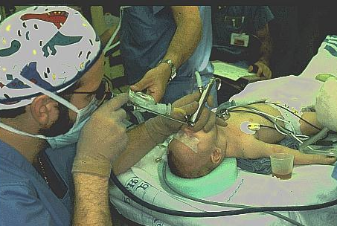
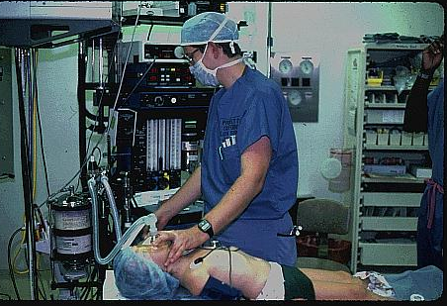
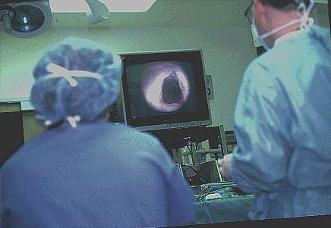
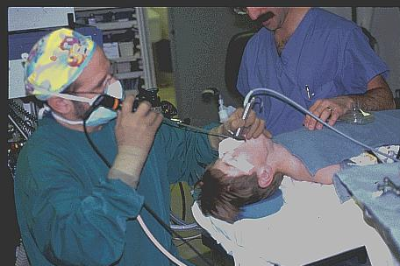
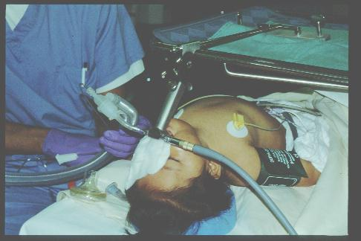
ENDOSCOPY TECHNIQUE

Slide 28
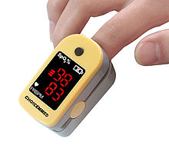
INVESTIGATIONS: OVERVIEW
LABORATORY STUDIES:
Generally, no investigations are required for mild stridor
On initial evaluation, pulse oximetry may be useful to determine the extent and severity of the stridor and respiratory compromise.
For moderate-to-severe cases, arterial blood gas may be needed.
Other laboratory evaluations may be performed as dictated by the clinical situation.

Slide 29
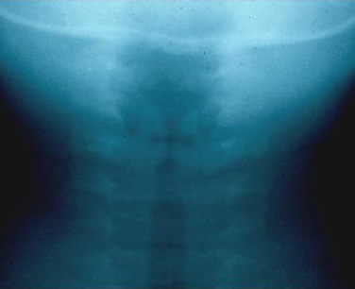
INVESTIGATIONS: OVERVIEW
IMAGING STUDIES:
Xray neck are chest: Useful to evaluate the airway and lungs.
Barium esophagram may be performed if vascular compression, tracheoesophageal fistula, GER, or neurological dysfunction is suspected.
Contrast-enhanced CT scanning can demonstrate mediastinal masses or aberrant vessels.
An MRI may be helpful in delineating lesions of the upper airway and vascular anomalies.
If GER is suspected, a pH probe or barium swallow may be performed to support the diagnosis.
Notes:
High-kilovoltage, short-exposure, endolateral airway radiographs (useful to demonstrate upper airway structures) or inspiratory and expiratory or lateral decubitus radiographs to demonstrate air trapping may be used to supplement AP and lateral radiographs.

Slide 30
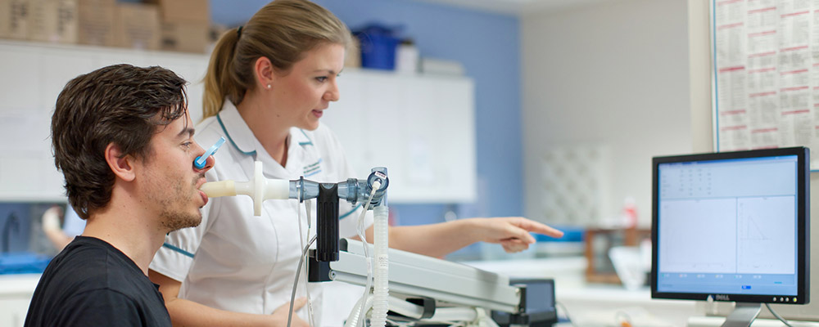
INVESTIGATIONS: OVERVIEW
OTHER TESTS
Pulmonary function testing (OPD –RPD)
Polysomnography (obstructive sleep apnea)
Notes:
High-kilovoltage, short-exposure, endolateral airway radiographs (useful to demonstrate upper airway structures) or inspiratory and expiratory or lateral decubitus radiographs to demonstrate air trapping may be used to supplement AP and lateral radiographs.

Slide 31
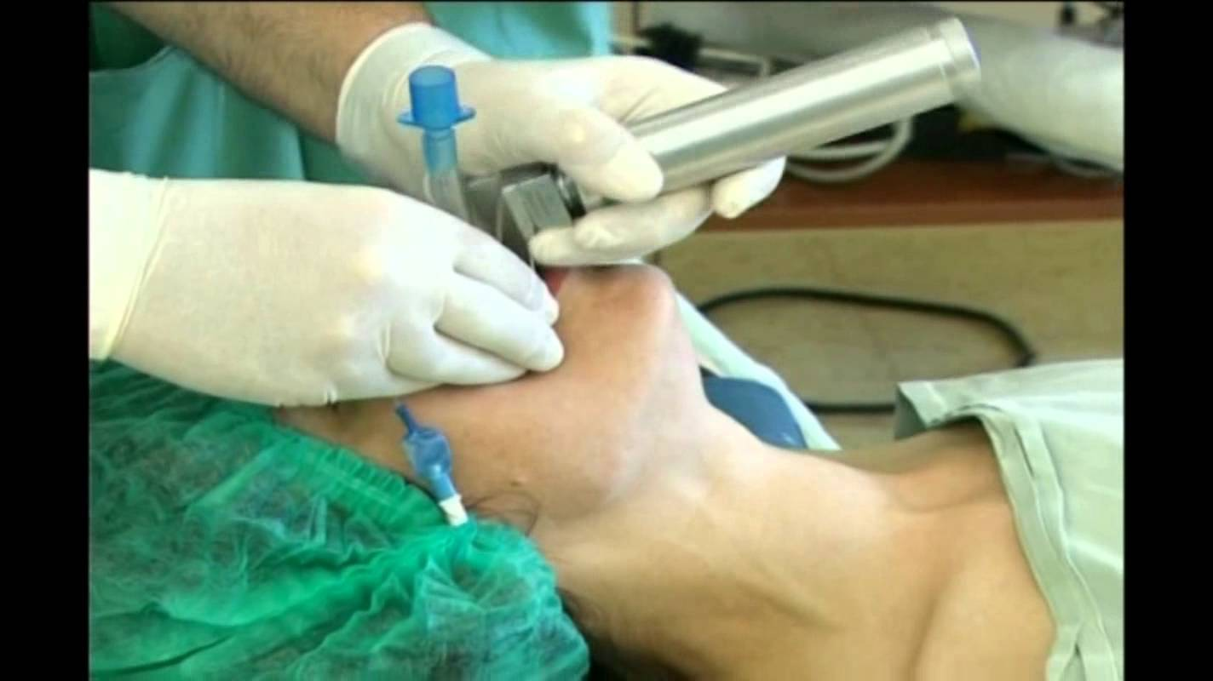

TREATMENT: MEDICAL CARE
Emergent management consists of ensuring that the airway is adequate.
If not, appropriate resuscitative measures must be initiated.
Some conditions (eg, epiglottitis, bacterial tracheitis) may require antibiotics, while steroids may be useful in other situations.

Slide 32
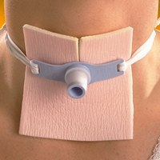
TREATMENT: SURGICAL CARE
Certain conditions, such as severe laryngomalacia, laryngeal stenosis, critical tracheal stenosis, laryngeal and tracheal tumors and lesions (eg, laryngeal papillomas, hemangiomas, others), and foreign body aspiration, require surgical correction.
Occasionally, tracheotomy is used to protect the airway to bypass laryngeal abnormalities and stent or bypass tracheal abnormalities.
Other conditions, such as retropharyngeal and peritonsillar abscess, may have to be dealt with on an emergent basis.

Slide 33
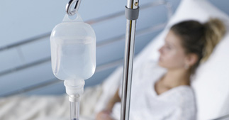
TREATMENT: DIET
Patients with moderate to severe stridor should be given nothing by mouth (NPO) in preparation for possible intubation, laryngoscopy, bronchoscopy, and tracheotomy.

Slide 34
WHO DO YOU CALL?
ENT surgeon
Peadiatrician
Anaesthetist / Intensivist
Pulmonologist
Cardiothoracic surgeon

Slide 35
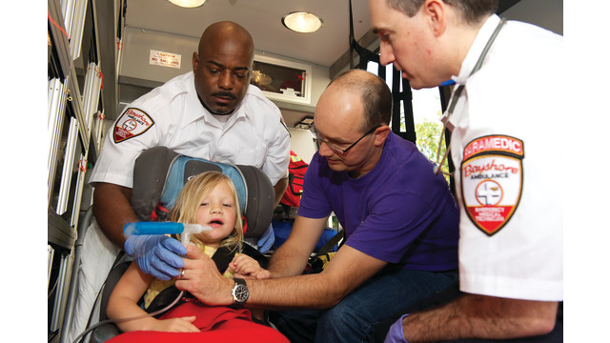
IMPORTANT CONDITIONS ASSOCIATED WITH STRIDOR

Slide 36
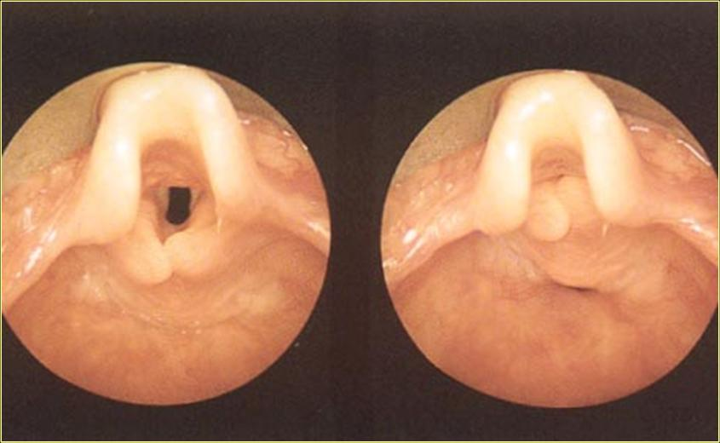
LARYNGOMALACIA
Most common cause of stridor in infants
  Varying severity & varying types
Presentation
  Staccato inspiratory stridor
  Worse with exertion, feeding, crying
  Noisy breathing generally begins at about 2-4 weeks of age
Office evaluation
  Character of stridor
  Positional changes / Mandibular thrust
  Flexible nasopharyngolaryngoscopy

Slide 37
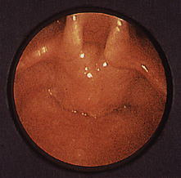
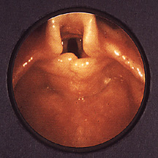
LARYNGOMALACIA
Endoscopic appearance
  Omega epiglottis
  Foreshortenend aryepiglottic folds
  Cuneiform prolapse
Ω
Notes:
Physical:
On examination, the baby is usually happy and appropriately interactive.
Mild tachypnea may be present.
Other vital signs are normal, and oxygen saturation is usually normal.
One can usually detect nasal airflow. The noise may be increased if the baby is placed supine.
The cry is normal. Hearing the baby's cry during the examination is important.
The noise is purely inspiratory.
The rest of the examination findings are unremarkable.

Slide 38
LARYNGOMALACIA
Vast majority are mild
Parental reassurance & education
  Transient worsening, gradual improvement
  Weight gain issues
  GERD issues- Consider GERD treatment if there is evidence on endoscopy

Slide 39
SEVERE LARYNGOMALACIA
Respiratory difficulty
Feeding difficulty
Failure to thrive
GERD
CNS abnormalities

Slide 40
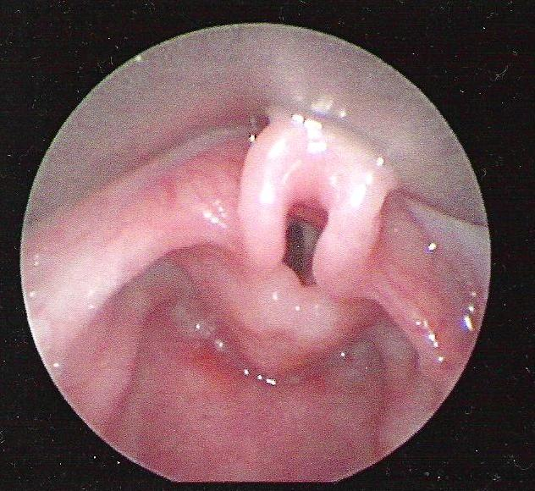
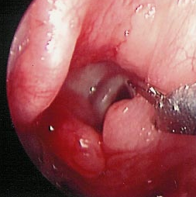
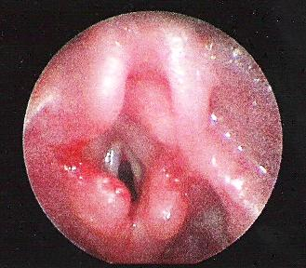
SEVERE LARYNGOMALACIA
Treatment
  Aryepiglottic fold division
  (Aryepiglottoplasty)
    Cold, Laser, Microdebrider
  Treat presumed GERD

Slide 41
TRACHEOMALACIA
Symptoms/ Signs:
  Tracheal wheeze
  “Brassy” cough
  Failure to thrive
  Increasing respiratory distress with growth
Diagnosis:
  Endoscopy – location, extent
  May not be idiopathic- look for contributing factors
Treatment:
  BiPAP / CPAP
  Tracheotomy – variable tube length
  Stenting – if no other choice

Slide 42
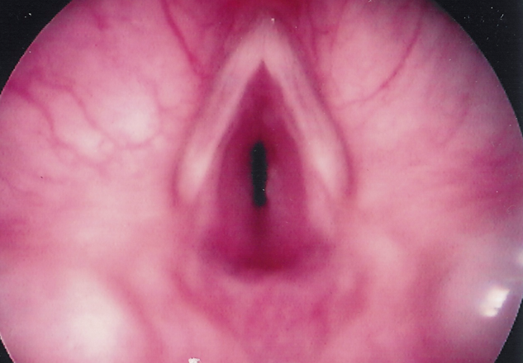
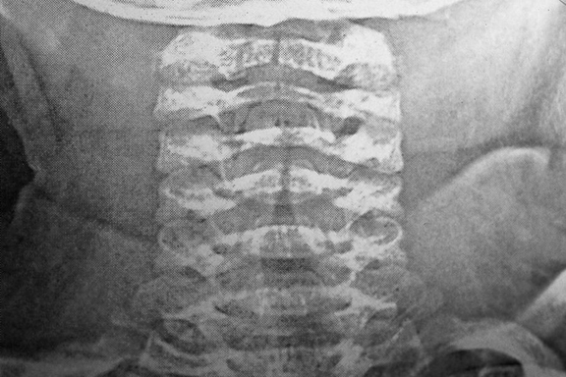
CROUP
(Laryngotracheobronchitis)
  Begins about 6 months of age !
    “Croup” before 6 months is not croup
  Xray AP of neck: symmetric subglottic narrowing (“steeple sign”)
  Endoscopically: 2 “sets” of vocal cords
  Hospitalized Patient: IV steroids, cold mist tent, hydration, O₂ sat monitor

Slide 43
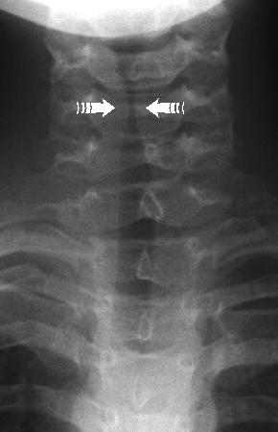
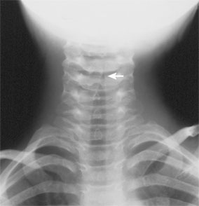

Slide 44
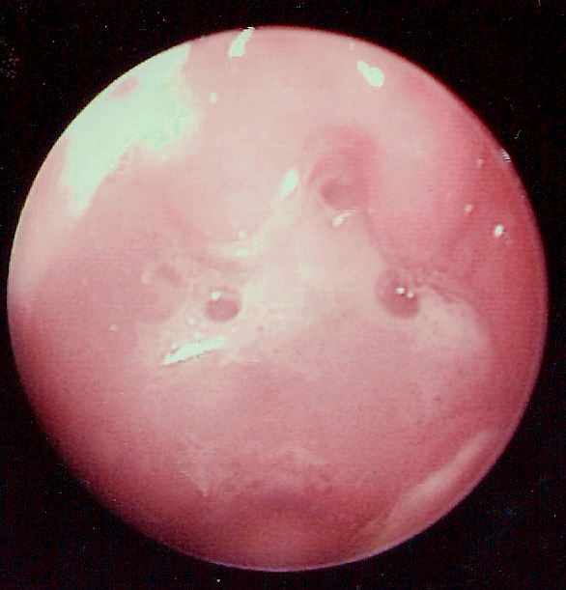
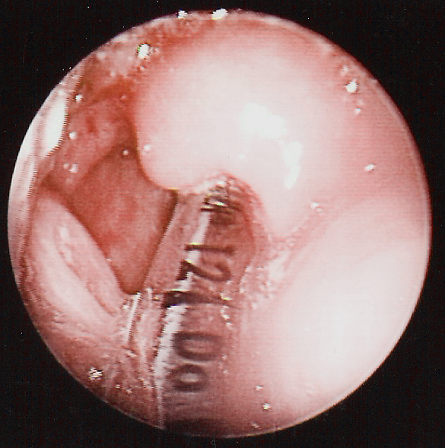
EPIGLOTTITIS
Traditionally caused by H. influenza b
  Suden onset, rapidly progressive course
Majority of cases seen now are caused by Staph
Consider immunocompromise
Treatment:
  Immediate intubation in OR with ENT present
  Send Cultures
  Appropriate antibiotics

Slide 45
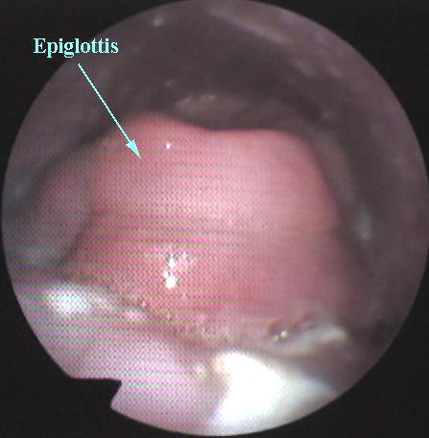
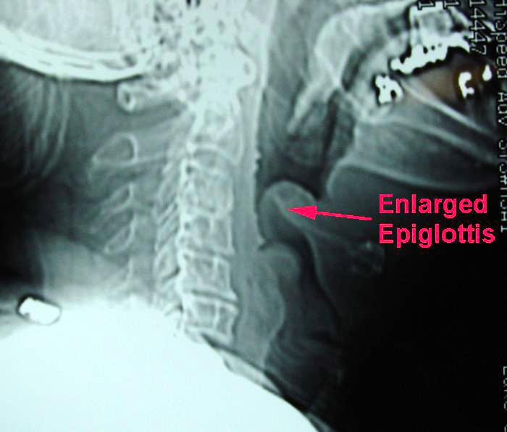

Slide 46
TRACHEITIS
Acute lower airway infection
  Typically develops as bacterial super-infection after viral croup
Acute airway obstruction, high fever, elevated WBC develop 2-3 days after onset viral illness
Treatment:
  Monitor, Humidified O₂
  Bronchoscopy for suctioning of purulent secretions and culture
Antibiotics:
  Consider Staph aureus (MRSA), H. flu, B-hemolytic strep, pneumococcus
  Treat for 7-10 days
Tracheotomy in severe cases

Slide 47
PEDIATRIC AIRWAY LESIONS MANAGED ENDOSCOPICALLY OR WITH OPEN SURGICAL REPAIR
Subglottic hemangioma
Glottic and Subglottic stenosis, webs
Vocal Fold Immobility
Laryngeal Clefts
Saccular Cysts

Slide 48
SUBGLOTTIC HEMANGIOMA
Classic scenario
  “Croup” symptoms generally begin 6-8 weeks of age
    No fever, good cry
  Respiratory distress/stridor: often treated as outpatient with oral steroids or inpatient with IV steroids with improvement
  “Croup” recurs several weeks later
Mean age of diagnosis is 4 months
  Delay due to misdiagnosis of symptoms
Proliferative phase then involutional phase

Slide 49
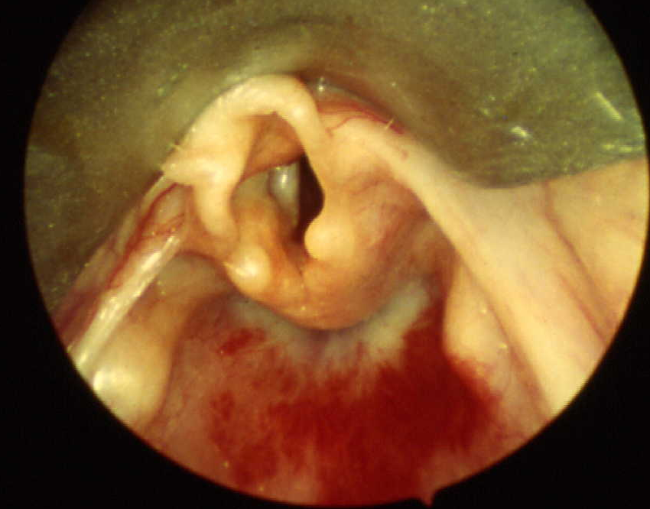
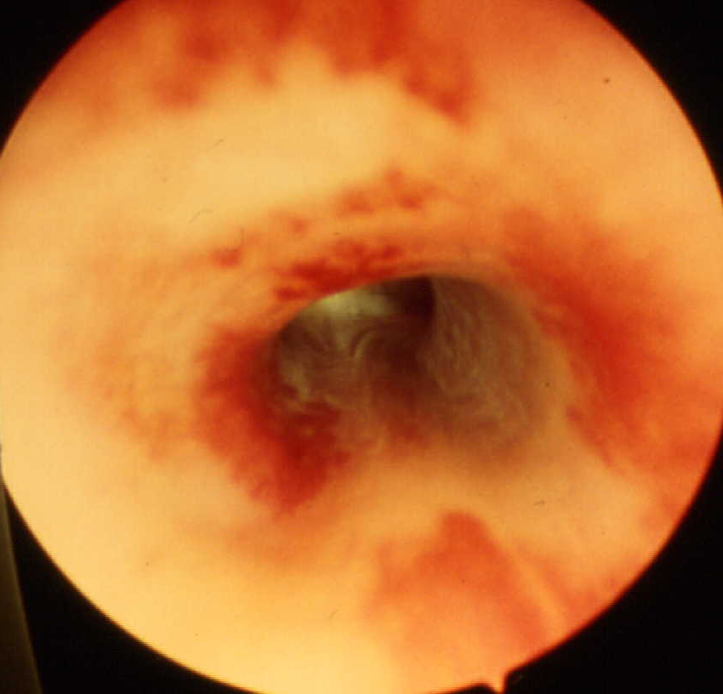
SUBGLOTTIC HEMANGIOMA
Assessment
  Endoscope entire airway
  Biopsy not essential (but can be done)
  CT/MRI--r/o extraluminal extension

Slide 50
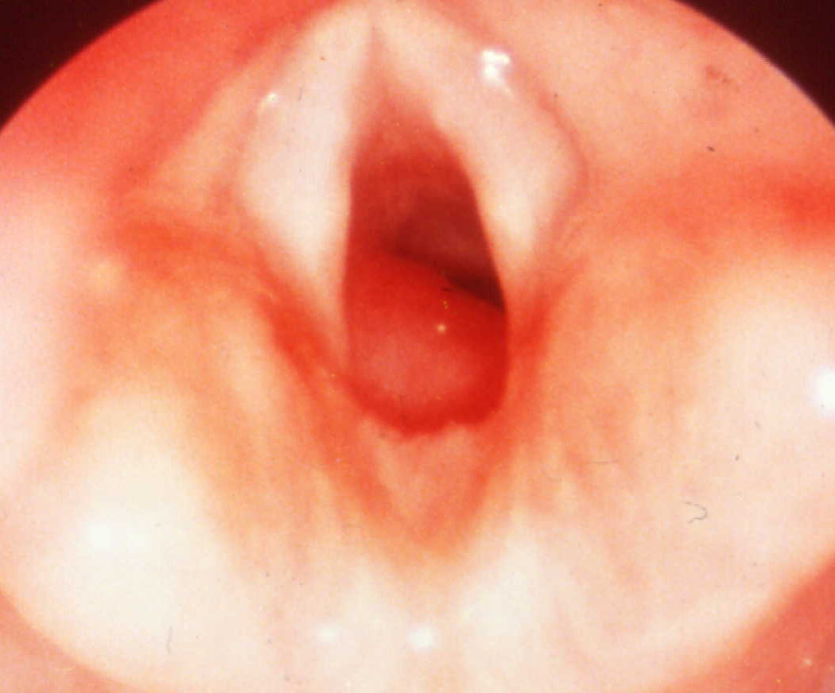
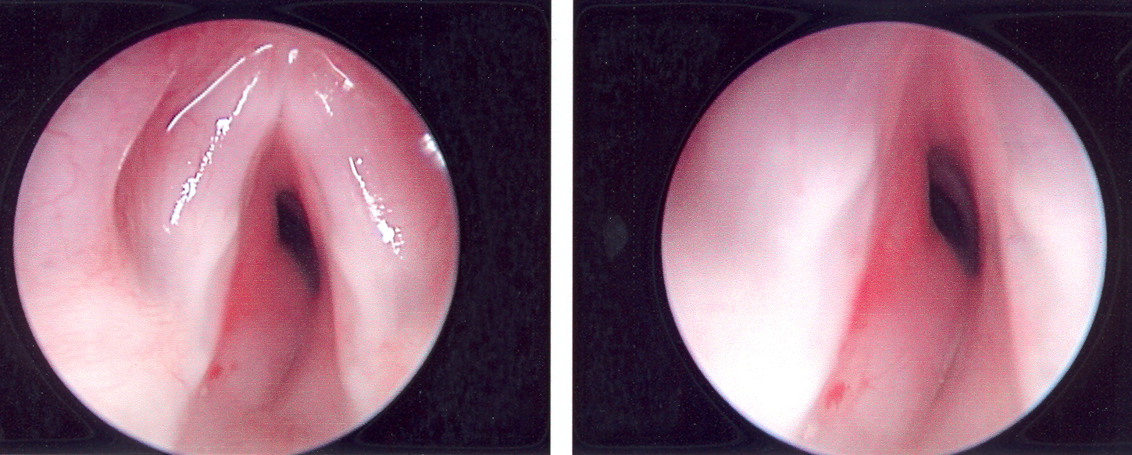
SUBGLOTTIC HEMANGIOMA
Classic Endoscopic appearance
  Smooth submucosal mass
  Posterolateral: left>right
  Bilateral lesions mistaken as “soft” subglottic stenosis

Slide 51
Management Options for Airway Hemangioma
Medical
Steroids
GERD therapy
(Interferon-spastic diplegia concerns)
(Vincristine-life threatening cases, neurotoxicity)
Surgical
Tracheostomy
Open surgical excision +/- expansion LTR
Endoscopic Excision
CO2 / KTP laser Ablation
Intralesional steroid injection
Latest: Propranolol

Slide 52
POST INTUBATION INJURIES
History
  Intubation--even transient
  NICU admission history
  Stridor with URI
  History of recurrent or prolonged croup or asthma
  Poor response to standard therapy

Slide 53
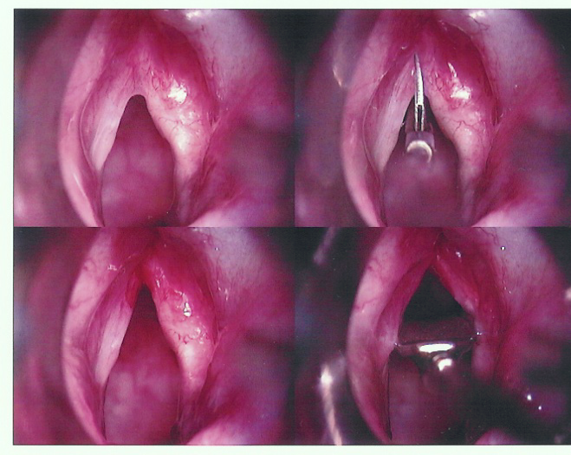
POST INTUBATION INJURIES
Anterior commissure web
  Weak, hoarse cry
  Mild-moderate respiratory distress
  Treatment:
    Endoscopic division
    Laryngeal keel
    Short term post-op intubation
    Mitomycin (?)

Slide 54
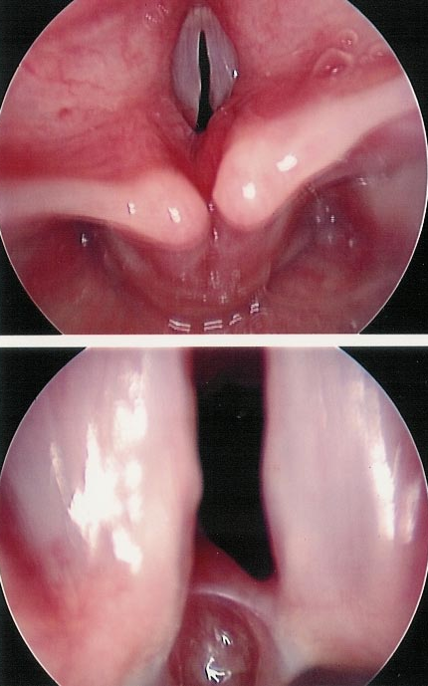
POST INTUBATION INJURIES
Interarytenoid web
  Difficult problem
  Mistaken for vocal cord paralysis
  Assess with MSL using 2 handed distraction technique
  Repair: endoscopic division alone rarely successful
    Mitomicin C
    Mucosal flap interposition
    Posterior cricoid expansion

Slide 55
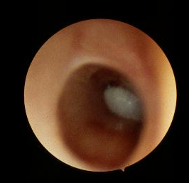
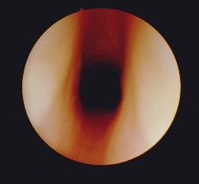
POST INTUBATION INJURIES
Subglottic Stenosis
  Assess entire airway
  Size & grade stenosis
    Grade I (0-50%)
    Grade II (50-70%)
    Grade III (70-99%)
    Grade IV (No visible lumen)
Treatment
  Observation (Grade I-II)
  Dilatation (Grade II-III)
  Laryngotracheal reconstruction (Grade III-IV)
  Treat for GERD

Slide 56



POST INTUBATION INJURIES
Subglottic Cysts
  Often multiple
  Removal
    Forceps
    Laser (CO₂ / KTP)
    Microdebrider

Slide 57
FOREIGN-BODY (FB) ASPIRATION
Peak incidence age 1 to 3 years
  90% of cases under age 4
Most commonly foods or toys
  Foods- peanuts, raisins, grapes, and hot dogs
  Vegetable matter can cause intense pneumonitis and subsequent pneumonia
  Toys/objects- typically small, smooth, and round

Slide 58
FOREIGN-BODY ASPIRATION
Signs & Symptoms
  Majority with abrupt onset of stridor or respiratory distress or failure
  Classically, but not always, laryngotracheal FB cause stridor and bronchial FB cause wheeze
  Some may be asymptomatic and normal P.E.
  FB should be suspected in unilateral wheeze

Slide 59
FOREIGN-BODY ASPIRATION
Other Signs & Symptoms
  History of choking episode
  Chronic cough
  History of persistent or recurrent pneumonia
  Persistent croup or asthma after adequate tx
  Pharyngeal pain

Slide 60
FOREIGN-BODY ASPIRATION
Diagnosis
  Maintain high index of suspicion
  Up to 1/3 of FB aspirations may have normal XR as most FB are not radiopaque
  CT may be helpful
  If clinical suspicion is high may need laryngoscopy and rigid bronchoscopy

Slide 61
FB Diagnosis
Complete obstruction-may see segmental atelectasis on XRay
Partial obstruction-ball valve effect, may cause obstructive emphysema
  B/l decubitus PA XR obstructed side remains inflated and diaphragm inferiorly displaced when involved side is down
Esophageal FB vs Tracheal FB
  Narrow flat FB in esophagus usually orients in coronal plane, vs sagittal plane if in the trachea

Slide 62

Where is the FB located?

Slide 63
FOREIGN-BODY ASPIRATION
Treatment
  ACLS-obstructed airway management, or follow predetermined ED protocols if available
  Obtain appropriate consults, ENT, Anesthesia or Pulmonary
  Removal by trained personal or transport to appropriate facility

Slide 64

Laryngeal Web
laryngeal web a web spread between the vocal folds near the anterior commissure

Slide 65

Stridor is an alarming symptom don’t let it pass
Thank YOU

