Slide 1
DRY EYES – Investigations & Treatment.
-NITHYAVARSHINI M ,
3RD yr MBBS ,
TAGORE MEDICAL COLLEGE AND HOSPITAL, CHENNAI

Slide 2
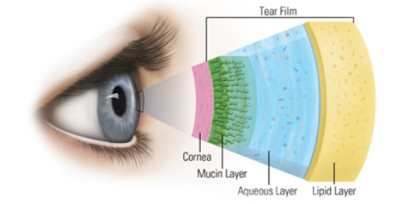
TEAR FILM

Slide 3
Tear film tests
Tear Break Up Time ( TBUT)
Schirmer’s test
Lissamine Green
Phenol Red thread test

Slide 4
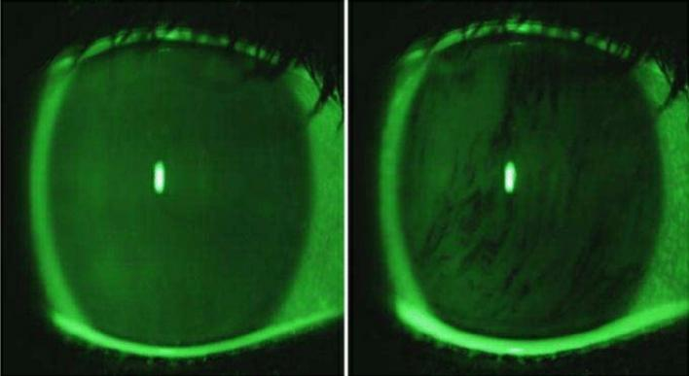
Tear Break Up Time
Fluorescein dye instilled into conjunctival sac.
Ask the patient to blink.
Illuminated with blue light .
Assess mucin components of tear
Assess the wettability of tear film .

Slide 5
TBUT :
TBUT : The interval between a blink and appearance of 1st spot on cornea is the tear break up time .
TBUT : <10sec → mucin deficiency
Dry spot at the same location→Corneal disease.

Slide 6
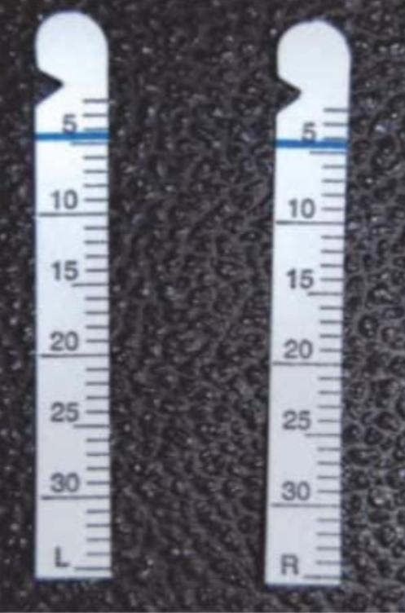
Schirmer test
Quantitative test for measuring tear production.
Whatman’s filter paper no.41 is used.

Slide 7
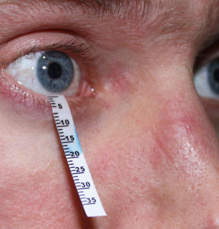
Schirmer’s test
To check lacrimal gland function.
Schirmer’s strip at the junction of lateral and middle 3rd of Lower lid .
Can be done in 2 ways :
Without topical anesthesia ( checks total secretion- reflex & basal )
With topical anesthesia ( checks only basal secretion)
Interpretation:
>15mm strip wet →Normal
<10mm strip wet →Dry eye

Slide 8
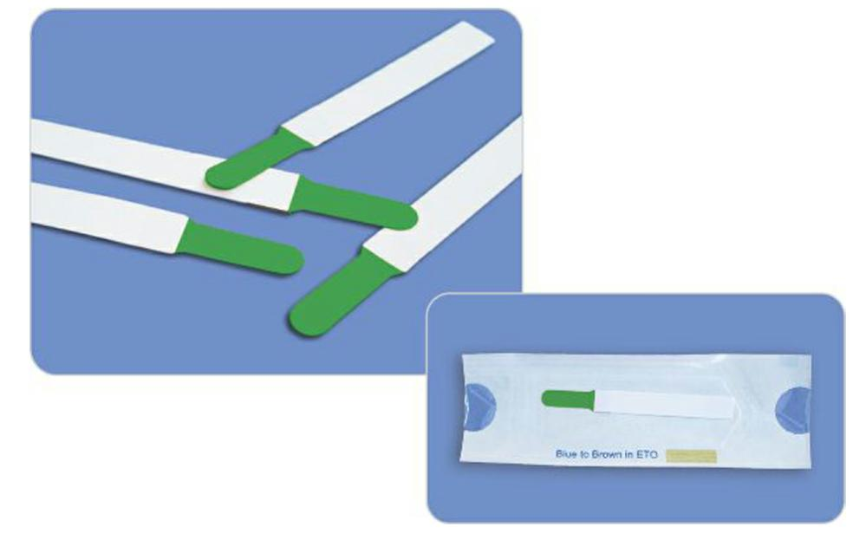
Lissamine green test
Can test conjunctival dryness.
Used in vitamin A deficiency.

Slide 9
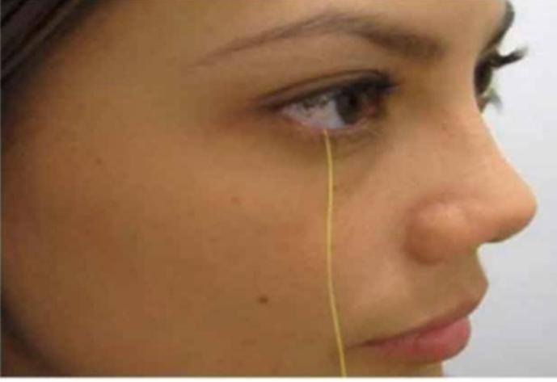
Phenol Red thread test
Use a thread impregnated with phenol red dye ( yellow in color). Which on contact with tears becomes red.
After 15 secs :
<6mm →Dry eyes
>15mm →Normal

Slide 10
Treatment
Tear substitutes
Topical cyclosporine
Mucolytic
Punctal plugs
Amniotic membrane graft .

Slide 11
THANK YOU

