Slide 1
Leucorrhea
Dr. Nisha

Slide 2
Leucorrhea
Increased vaginal discharge
Physiologic/Pathologic

Slide 3
Normal Vaginal Discharge
Creamy white discharge
Vulvar secretion
Bartholin glands
Sweat glands
Sebaceous glands
Skene glands
Vagina
Cervix
Endometrial glands
Fallopian tubes

Slide 4
Normal Vaginal Discharge
Increased when
Ovulation-endocervical glands
Premenstrual phase
Pregnancy
pH<4.5

Slide 5
Physiological Vaginal Discharge
Newborns
Puberty
Pregnancy

Slide 6
Pathological Vaginal Discharge
Vaginitis in infancy and childhood
Atrophic vaginitis
Candidiasis
Bacterial vaginosis
Trichomonas vaginitis
Foreign bodies
Neoplasm
Urinary and fecal discharge

Slide 7
Vaginitis in infancy and childhood
Low immunity
Age 1-5 years
Infection/Foreign body/Tumor
Wet smear, Gram stain, culture, speculum
Treatment
Rest
Antibiotics
Estrogen

Slide 8
Atrophic Vaginitis
Postmenopause
Decreased estrogen
Vaginal wall thinning
Decreased acidic environment
Yellow/Green/Bloody
Pruritic/Painful
Dysuria
Dyspareunia/Postcoital bleeding
Vaginal wall thinning, patchy ulceration, adhesive vaginitis

Slide 9
Atrophic vaginitis
PAP smear, Gram stain, culture
+/-Cervical biopsy
Treatment:
Antibiotics
Estrogen

Slide 10
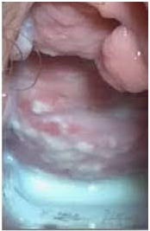

Slide 11
candidiasis
Uncomplicated VVC
Sporadic or infrequent
Mild to moderate symptoms
Mostly due to Candida albicans
Non-immunocompromised women
Complicated VVC
Recurrent VVC
Severe symptoms
Non-albican candidiasis
Uncontrolled diabetes
Immunosuppression

Slide 12
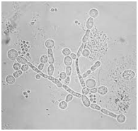
Candidiasis
Inflammation and curd-like discharge
Yeast cells/Pseudohyphae
Predisposing factors
Diabetes
Obesity
Pregnancy
Low immunity
Premenstrual period

Slide 13
Candidiasis
KOH preparation, Gram stain (positive)
Treatment:
Uncomplicated
Clotrimazole V.P. (200) Vg suppo OD 3 days
Itraconazole (400) PO stat
Fluconazole (150) PO stat
Complicated
Clotrimazole V.P. (100) Vg suppo OD 14 days then Clotrimazole V.P. (500) Vg suppo weekly for 6 months
7-14 days of topical therapy
150 mg oral dose of fluconazole every third day for a total dose of 3 days [day 1, 4, 7]

Slide 14
Bacterial Vaginosis
Most prevalent cause of vaginal discharge
White, homogenous discharge, uniformly adherent to vaginal walls with redness
Increased (foul-smelling) discharge
Decreased amount of Lactobacilli
Increased amount of anaerobes
Mostly asymptomatic
Low immunity

Slide 15
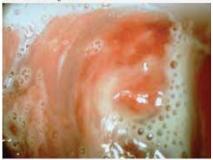

Slide 16
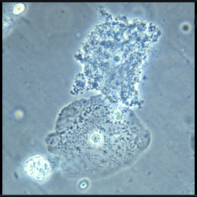
Bacterial Vaginosis
Amsel criteria (3/4)
Grey-white discharge
pH>4.5
Clue cells
Whiff test
Treatment
Metronidazole (400) tds for 7 days
Doxycyclin (100) bd for 7 days

Slide 17
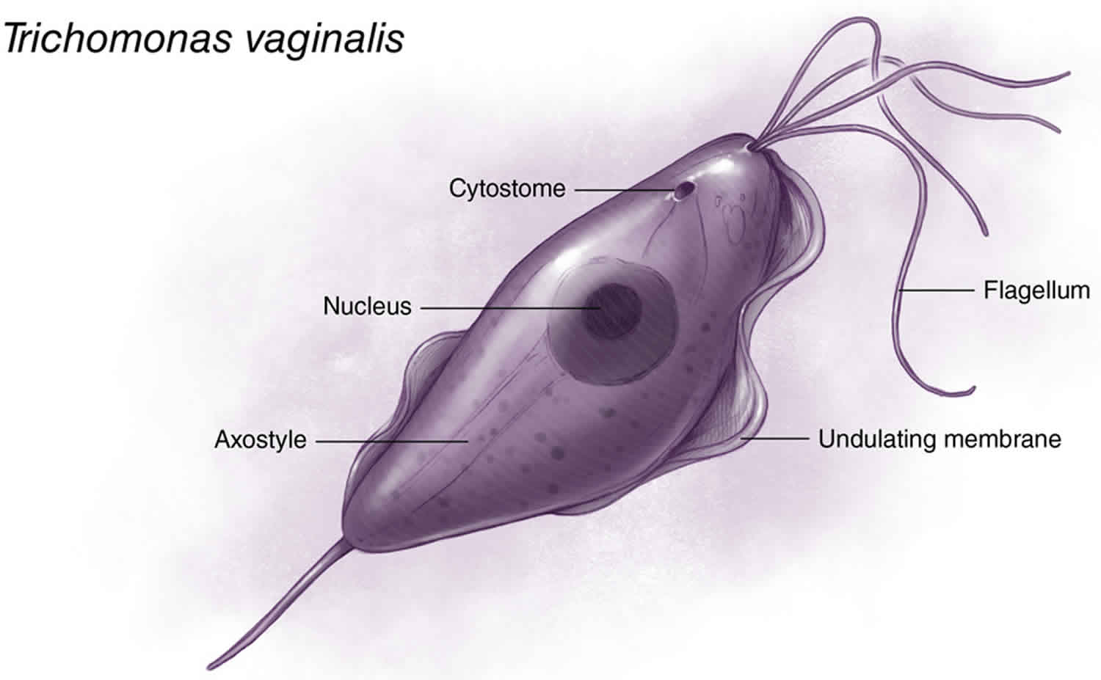
Trichomonas vaginitis
Anaerobic flagellated protozoa
Yellowish green, frothy, white discharge
Itchy
Dysuria, dyspareunia
Vaginal mucosal inflammation
Strawberry cervix

Slide 18
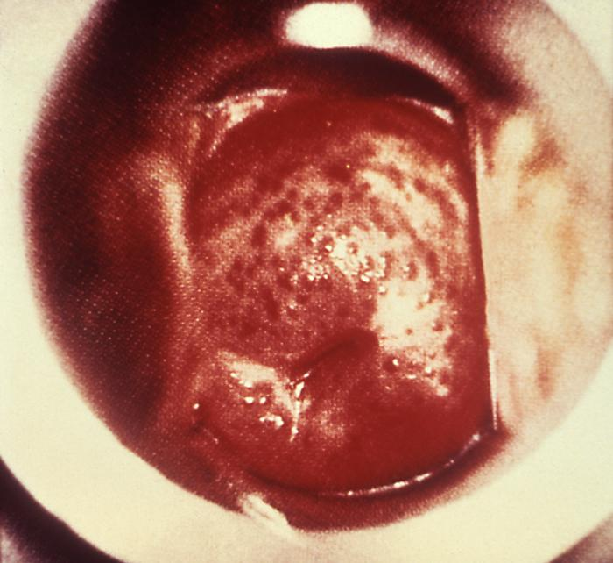

Slide 19
Trichomonas Vaginitis
Wet smear, Gram stain, NAAT
Treatment
Metronidazole (400) tds for 7 days
Doxycyclin (100) bd for 7 days
Must also treat partners

Slide 20
Mucopurulent cervicitis
Mucopurulent discharge
Dysuria
Vulval inflammation
N. gonorrhoeae, C. trachomatis, HSV
Gram stain -> intracellular gram-negative diplococci

Slide 21
Foreign Bodies
Children
Adults – contraceptive devices, pessary, swabs, tampons
Purulent vaginal discharge; foul-smelling, bloody
Speculum; may use nasal or aural speculum
Removal then antiseptics

Slide 22
Neoplasm
Benign/Malignant
Leucorrhea
purulent, foul-smelling, bloody
if infected/malignant

Slide 23
Approach
Careful history
- Should include menstrual cycle, vaginal hygiene practice, sexual behavior and drug history
Examination
- Assess color, odor, amount (profuse or scanty), character (curdy or thin), associated vulvar abrasion or erosion, urethral meatal discharge, presence or absence of foreign bodies or IUD thread.

Slide 24
Prevention and counseling
Educate and counsel patient and partner
Advise sexual abstinence during the course of treatment
Promote barrier contraception
Consider immunization against Hepatitis B
Reschedule visit after 7 days
If symptoms persist, assess whether it is due to treatment failure or reinfection

Slide 25
Differntial diagnosis
Cervicitis
PID
Fistulas/prolapse
Allergic
Non-infectious irritation of vulva

Slide 26
THANK YOU

